Slide 1
Object Oriented Programming in JAVA
(Practical#10)

Slide 2
Objective: To become familiar with Event Handling .
An event is an action that occurs when the user interacts with the application or a GUI component.
When the user interacts with a GUI component, the interaction is known as an event.
For example, clicking on a button, moving the mouse, entering a character through keyboard, selecting an item from list, scrolling the page, etc.
The code that performs a task in response to an event is called an Event Handler, and the over all process of responding to event is known as Event Handling.

Slide 3
Event-Handling with Swing
Swing uses the AWT event-handling classes (in package java.awt.event).
The Event Model has the following key participants / members.
Event Source, Event Object and Event Listener −
Event Source − is a particular GUI component with which the user interacts.
Upon triggered, the source object creates an event object to capture the action (e.g., mouse-click x and y, texts entered, etc). This event object will be messaged to all the registered listener object(s), and an appropriate event-handler method of the listener(s) is called-back to provide the response. In other words, triggering a source fires an event to all its listener(s), and invoke an appropriate event handler of the listener(s).

Slide 4
The Event Model has the following key participants / members.
Event Object encapsulates information about an event that occurred such as reference to the event source, and any event-specific information that may be required by the event listener for it to handle the event.
Event Listener − It is also known as event handler. The listener is responsible for generating a response to an event. From the point of view of Java implementation, the listener is also an object. The listener waits till it receives an event. Once the event is received, the listener processes the event. The event listener uses the event object to respond to the event.

Slide 5
The Event Model has the following key participants.
Event Source −
Event Object
Event Listener − It is also known as event handler. Commonly, event-handling methods are called event handlers.
An event listener for a GUI event is an object of a class that implements one or more of the event-listener interfaces from package java.awt.event.

Slide 6
The java.awt.event package defines classes and interfaces used for event handling.The members of this package fall into three categories:
Events The classes with names ending in "Event" represent specific types of events, generated by the AWT or by one of the AWT or Swing components.
Listeners The interfaces in this package are all event listeners; their names end with "Listener". These interfaces define the methods that must be implemented by any object that wants to be notified when a particular event occurs. Note that there is a Listener interface for each Event class.
Adapters Each of the classes with a name ending in "Adapter" provides a no-op implementation for an event listener interface that defines more than one method. When you are interested in only a single method of an event listener interface, it is easier to subclass an Adapter class than to implement all of the methods of the corresponding Listener interface.

Slide 7
Steps to setup event handling for a GUI component
Import classes and interfaces from java.awt.event package.
Implement an appropriate (suitable) event listener
(interface), known as the ActionLinener in the class.
Define an appropriate event handler for processing the events
Registering the event handler for a GUI component.

Slide 8
Event Handling with Inner/Nested Classes.
For each GUI component such as (JLabel, JFrame …) there is a specific class in the swing package.
These GUI components can generate a variety of events (several events), and each event is handled/processed by a particular type of event handler.
OR Each event is represented by a class.
Event Handler contains the code that will execute when an event occurs.
OR An Event Handler will perform the task in response to an event.

Slide 9
Event Handling with Inner/Nested Classes.
How to Define Event Handlers:
Java provides or uses nested classes to implement Event Handlers.
Java allows you to declare classes inside classes (class within a class ) called nested classes.
Nested classes are called inner classes and are used frequently for event handling.

Slide 10
Event Handling with Inner/Nested Classes.
Steps to setup event handling with inner classes.
Import classes and interfaces from java.awt package.
Define an appropriate event handler for processing the events
So Create an inner class that represents the event handler.
Implement an appropriate event listener, in the class.
Registering the event handler for GUI component.

Slide 11
Mouse Event Handling
The MouseListener and MouseMotionListener event-listener interfaces for handling mouse events.
The listener interface for receiving "interesting" mouse events (press, release, click, enter, and exit)
on a component. (To track mouse moves and mouse drags, use the MouseMotionListener.) Methods of interface MouseListener
public void mousePressed( MouseEvent event )
Called when a mouse button is pressed with the mouse cursor on a component.
public void mouseClicked( MouseEvent event )
Called when a mouse button is pressed and released on a component without moving the mouse cursor.
public void mouseReleased( MouseEvent event )
Called when a mouse button is released after being pressed. This event is always preceded by a mousePressed event.
public void mouseEntered( MouseEvent event )
Called when the mouse cursor enters the bounds of a component.
public void mouseExited( MouseEvent event )
Called when the mouse cursor leaves the bounds of a component.

Slide 12
Methods of interface MouseMotionListener
public void mouseDragged( MouseEvent event )
Called when the mouse button is pressed with the mouse cursor on a component and the mouse is moved.
This event is always preceded by a call to mousePressed.
public void mouseMoved( MouseEvent event )
Called when the mouse is moved with the mouse cursor on a component.

Slide 13
ActionListener vs MouseListener
Action listeners are probably the easiest — and most common — event handlers to implement.
You implement an action listener to define what should be done when the user performs certain operation.
The listener interface for receiving action events. The class that is interested in processing an action event implements this interface, and the object created with that class is registered with a component, using the component'saddActionListener method. When the action event occurs, that object's actionPerformed method is invoked.
An action event occurs, whenever an action is performed by the user. Examples: When the user clicks a button, chooses a menu item, presses Enter in a text field. The result is that an actionPerformed message is sent to all action listeners that are registered on the relevant component.

Slide 14
The usage of this interfaces is completly different.
While you can use the MouseListener only in combination with gui elements, the ActionListener is also used when there is no gui, for example in combination with a timer.
Simply, the ActionListener executes when the button was clicked. With a MouseListener, you need to have focus, make sure the x and y coordinates are in the right place, and such. ActionListener is almost always the simplest way to do it.
A MouseListener only handles low-level mouse events.
for receiving "interesting" mouse events (press, release, click, enter, and exit) on a component. (To track mouse moves and mouse drags, use the MouseMotionListener.)
An ActionListener is used to handle the logical click of a button. A click happens:
when the mouse is pressed then released on a button,
or when the keyboard shortcut of that button is used,
or when the button has the focus and the space bar is pressed,
or when the button is the default button and Enter is pressed,
or when the button's click() method is called programmatically

Slide 15
KeyListener Interface
The listener interface for receiving keyboard events (keystrokes).
Keyboard actions are handled by KeyListener. Keyboard generates KeyEvent. Three types of actions can be done with keyboard – by pressing the key, by releasing the key and typing the key. These actions are represented by three abstract methods of KeyListener.
The listener interface for receiving keyboard events (keystrokes). ... A keyboard event is generated when a key is pressed, released, or typed. The relevant method in the listener object is then invoked, and the KeyEvent is passed to it.

Slide 16
Methods of KeyListener
void keyTyped(KeyEvent e)
Invoked when a key has been typed.
void keyPressed(KeyEvent e)
Invoked when a key has been pressed
void keyReleased(KeyEvent e)
Invoked when a key has been released

Slide 17
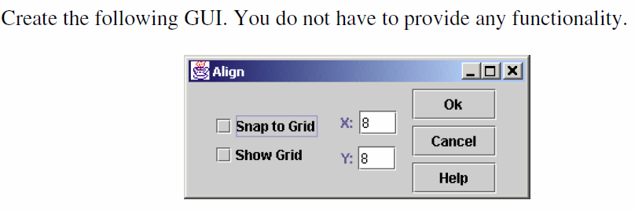
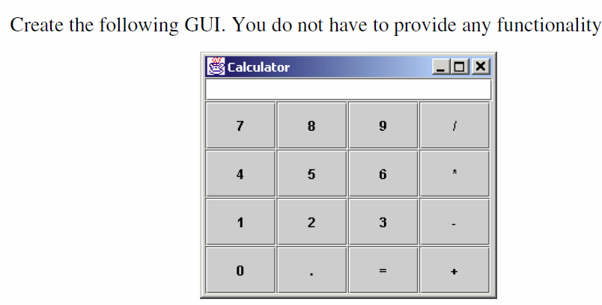
Tasks For Lab # 7
Task # 1
Task # 2

